Slide 1

Sprocket Central Pty Ltd
Data analytics approach
Aman Agrawal

Slide 2
Agenda
Introduction
Data Exploration
Model Development
Interpretation

Slide 3
Introduction
Identify and Recommending High Value Customers
Outline Of Problem
Approach For Data Analysis
Sprocket Central is a company that specialize in high quality bike and accessories.
The Marketing team is looking to boost sales.
To target 1000 new customer that will bring the highest value to the business.
Bike Related Purchase for the last 3 years based on Gender
New and Old customer age distribution.
Job industry distribution.
Profit Contribution based on Job Industry
Customer Segment
Customer classification.

Slide 4
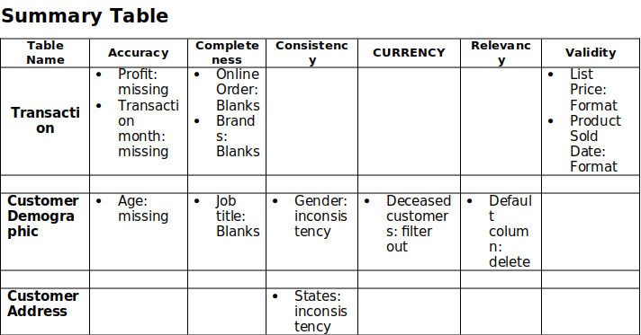
Data Exploration
Data Quality Assessment and 'Clean up'
Key Issues for Data Quality Assessment
Accuracy : Correct Values
Completeness : Data Fields with Values
Consistency : Values Free from Contradiction
Currency : Values up to Date
Relevancy : Data items with Value Meta-data
Validity : Data containing allowable values
Uniqueness : Records that are Duplicated
Place any supporting images, graphs, data or extra text here.

Slide 5
Data Exploration
Bike Related Purchase Over Last 3 Years Based on Gender
Over the last three years about 50% of bike related purchases were made by females to 47.8% of purchase made by males. Approximately 1.9% were made by unknown gender.
Females make up majority of bike related sales

Slide 6
Data Exploration
'New' and 'Old' Customer Age Distribution
Most of the customer are aged between 40-49 in 'New'. In 'Old' majority of customers are aged between 40-49 also.
The lowest age groups are 80+ in 'New' and 70+ in 'Old'
The 'New' customer list suggest that age groups 40-49, 50-59, 60-69 are most populated
The 'Old' customer list suggest 20-69 are the most populated

Slide 7
Data Exploration
Job Industry Distribution
20% of the 'New' customer are in manufacturing and financial services.
The smallest number of customers are in Agriculture and Telecommunications.
Almost similar pattern in 'Old' customer list at 20% and 19% in manufacturing and financial services respectively.

Slide 8
Data Exploration
Profit Distribution Based on Job Industry Sector
The Top 3 job industry sector bringing the highest profit are : Financial Services, Manufacturing and Health Sector.
These can be obvious as most of these industry sectors are based within the city or the outskirts of the city therefore the consumers prefer bikes for commuting
Most of the industry sectors have returned less than $1000,000 in profits

Slide 9
Data Exploration
Customer Segment Distribution
Majority of the customer are from Mass Customer Followed by High Net Worth and last Affluent

Slide 10
Model Development
Customer Classification – Targeting High Value Customers
These are the high value customers that should be targeted from the new list :
Most of the high value customers will be female compared to male
Working in the Financial Services , Health and Manufacturing Industry Sector
Aged between 30-59
Who belong to the mass customer and High net worth category

Slide 11
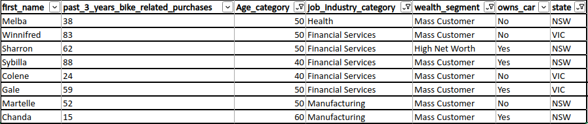
Interpretation
Summary Table For High Value Customer
Here is a snapshot of a few customer that will come under the High Value Customer Classification

Slide 12
Thank You

